Slide 1
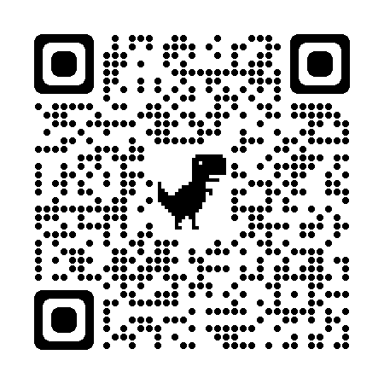
An introduction to AI tools
jsoma.github.io/2023-abraji-ai-workshop
investigate.ai
normalai.org
Jonathan Soma
Columbia University
@dangerscarf
js4571@columbia.edu

Slide 2
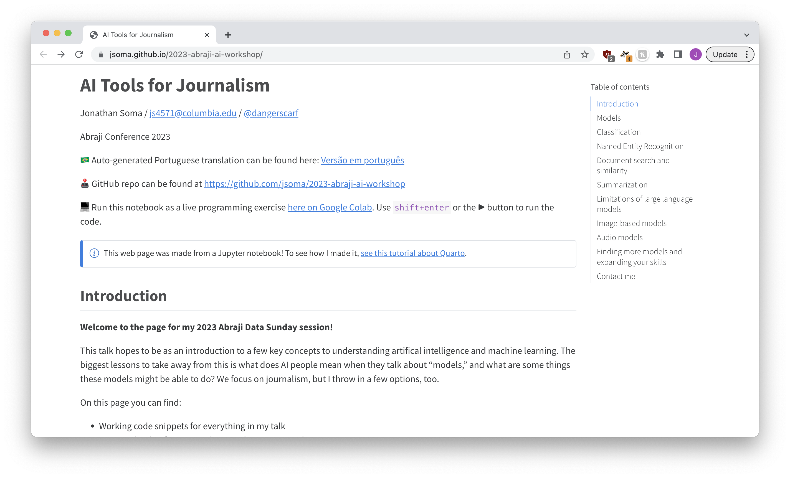

jsoma.github.io/2023-abraji-ai-workshop

Slide 3
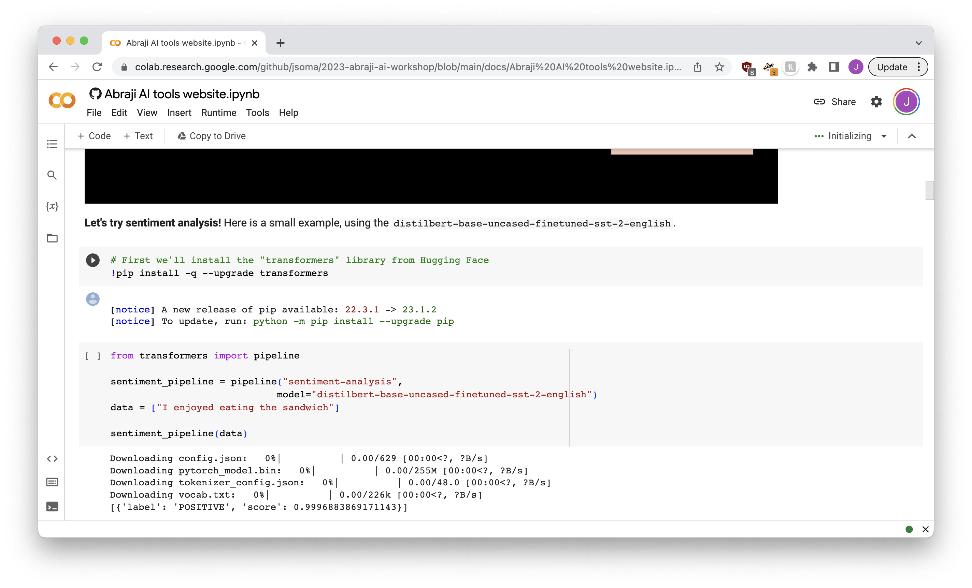
Shift+enter
Shift+enter
Shift+enter
Shift+enter
Shift+enter
Shift+enter
Shift+enter
Shift+enter
Shift+enter
Shift+enter

Slide 4
The roadmap
STEP ZERO

Slide 5
What is a “model?”
Sentiment analysis + text classification
Training and fine-tuning models
Large language models (and limitations)
Beyond text models

Slide 6
What is a “model?”
STEP ONE

Slide 7
Words you may have heard
GPT-2, GPT-3, GPT-3.5-turbo, GPT-4, Bard, Claude, LLaMa, Stable Diffusion, Midjourney, DALL-E 2, Imagen
Let’s learn what they mean

Slide 8



model
input
output

Slide 9
Sentiment analysis
STEP ONE, PART ONE
I love to eat cookies is POSITIVE
I hate when it rains is NEGATIVE

Slide 10



sentiment analysis model
text
POSITIVE or NEGATIVE

Slide 11
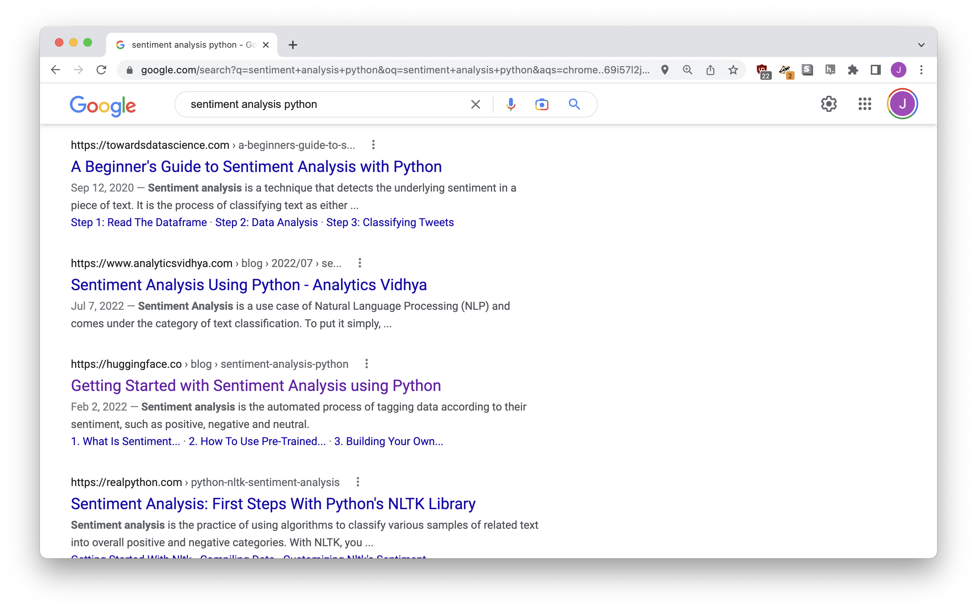
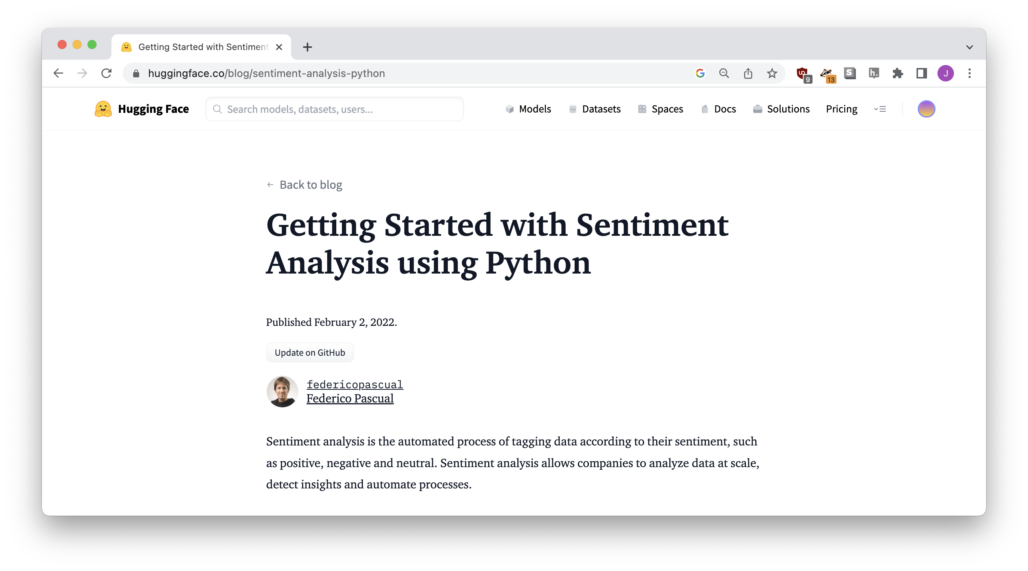

Slide 12
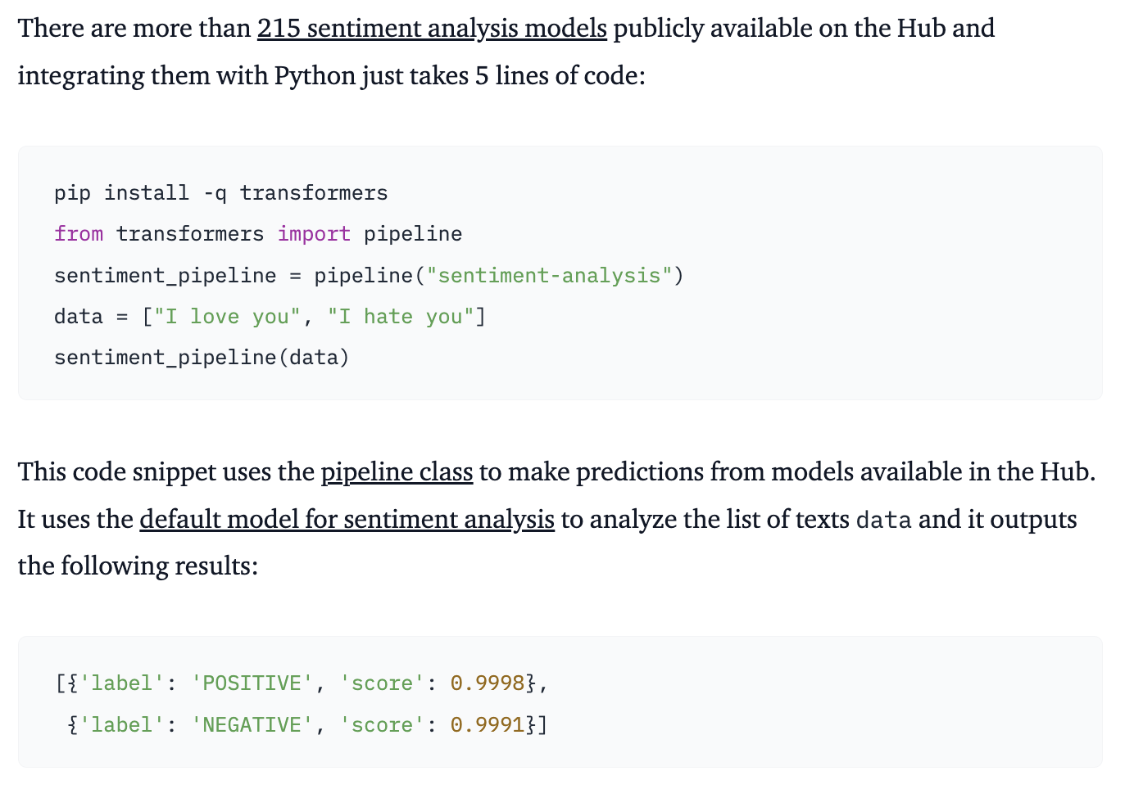

Slide 13
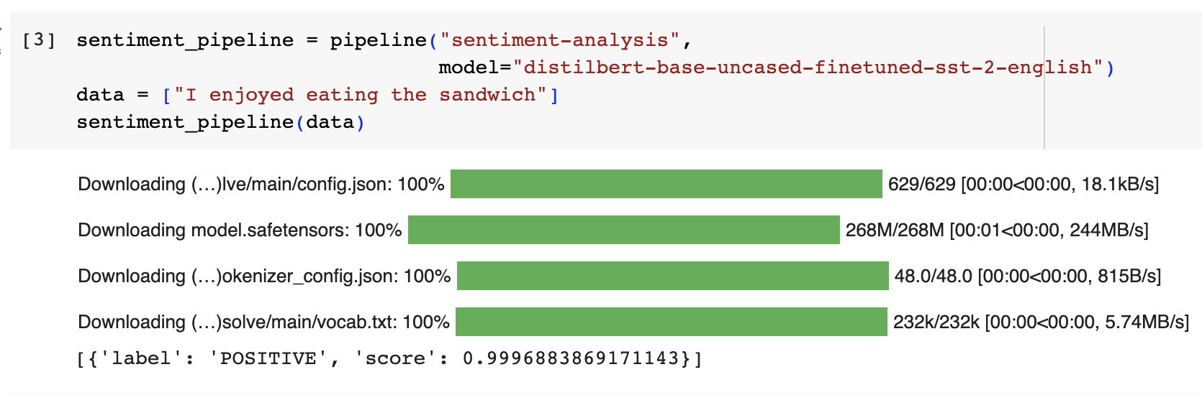
[{
'label': 'POSITIVE’,
'score': 0.999688386171143
}]
Notes:
It does some stuff but we also get in trouble

Slide 14
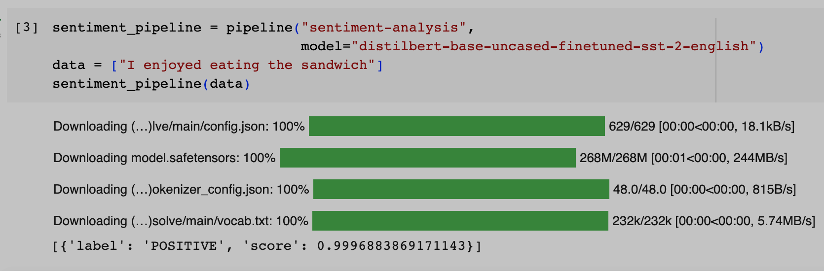


“model”!!!
Notes:
It does some stuff but we also get in trouble

Slide 15
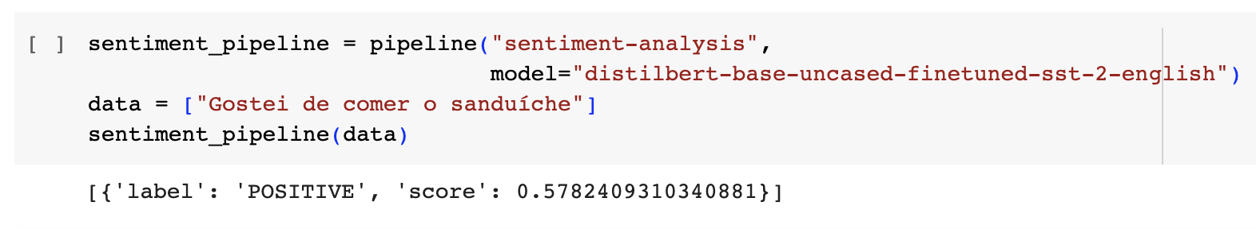


distilbert-base-uncased-finetuned-sst-2-english
[{
'label': 'POSITIVE’,
'score’: 0.5782409210340881
}]

Slide 16
distilbert-base-uncased-finetuned-sst-2-english
“english”

Slide 17
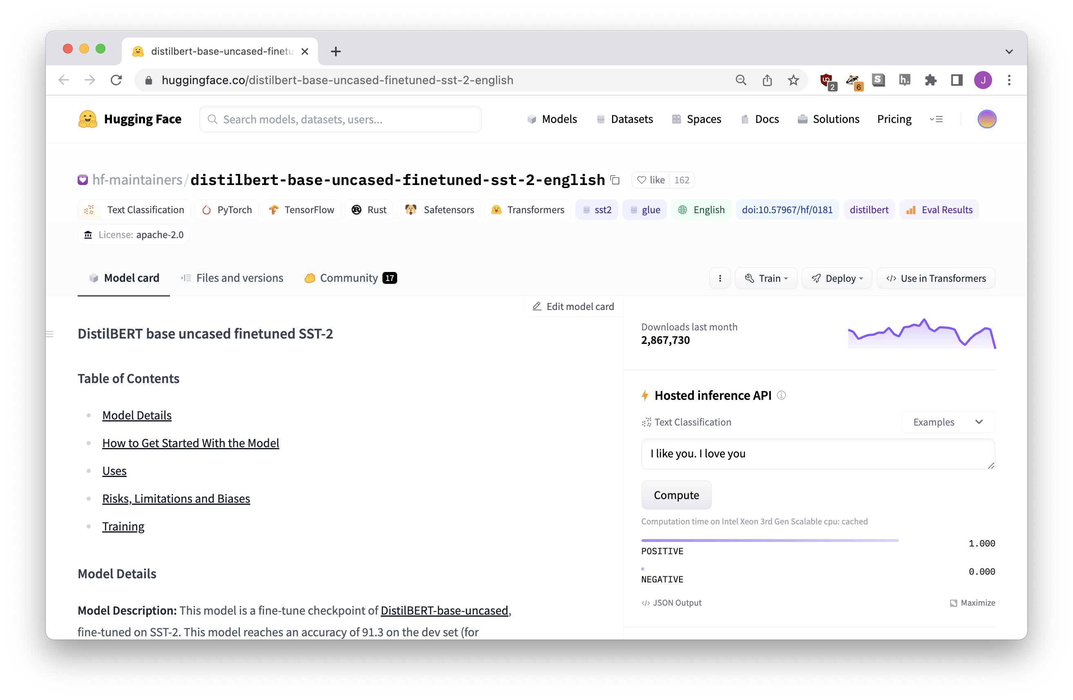
huggingface.co
(where all the models live)

Slide 18
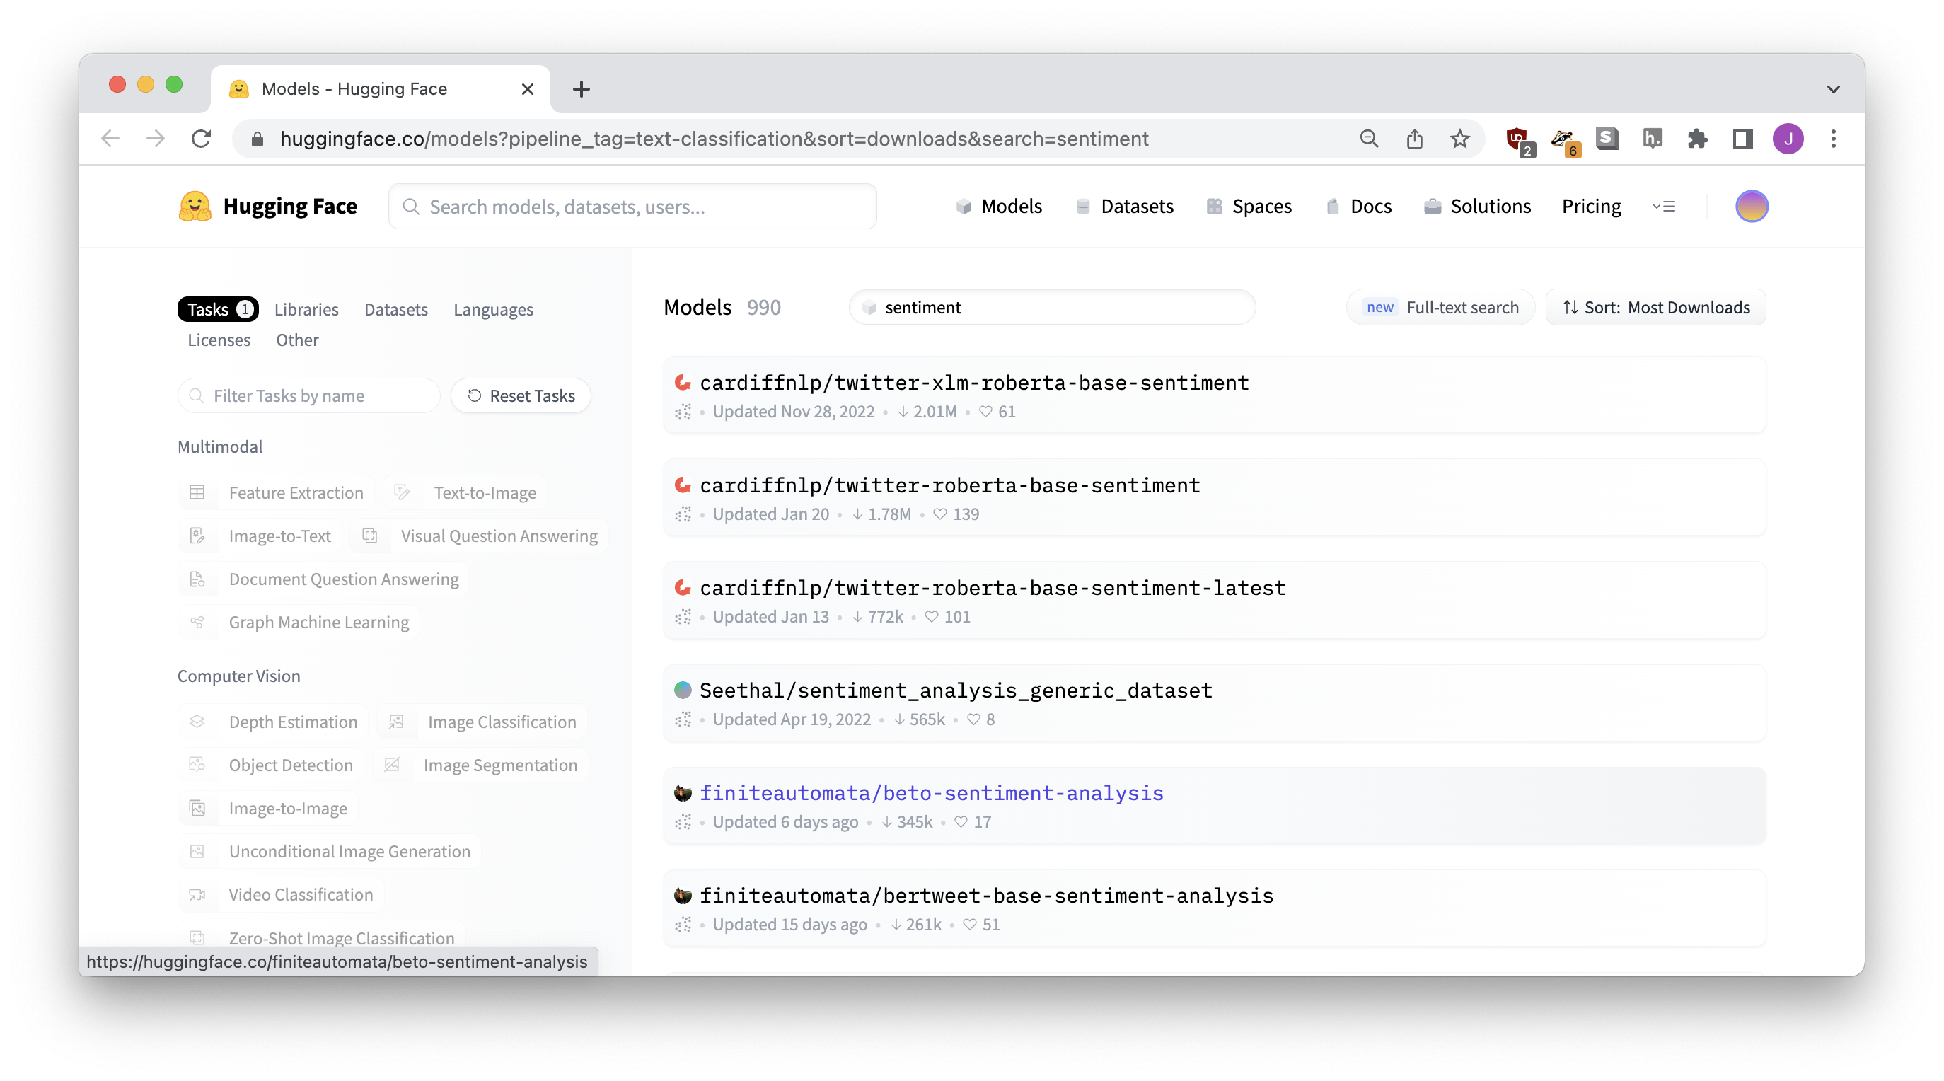
Notes:
I don’t know what’s going on but the first one is obviously the most popular

Slide 19
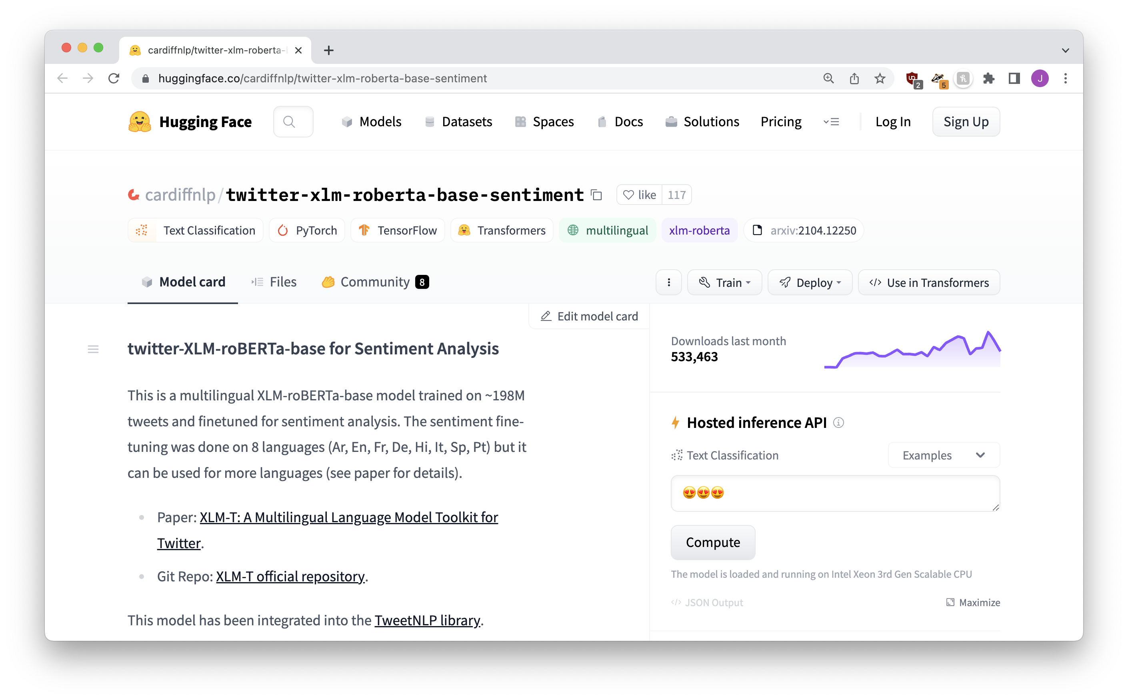

Slide 20
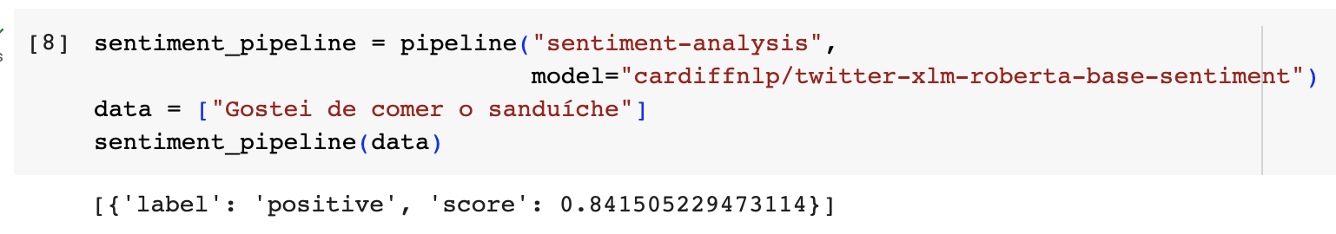
[{
'label': 'POSITIVE’,
'score’: 0.841505229473114
}]

Slide 21





english model
not great
portuguese text
multi-language model
better
Notes:
There isn’t just ONE sentiment analysis

Slide 22
There isn’t just one “sentiment analysis” – different models give different results!
Different models might perform better or worse at different tasks or languages
But why?? How?? Where do they come from??

Slide 23
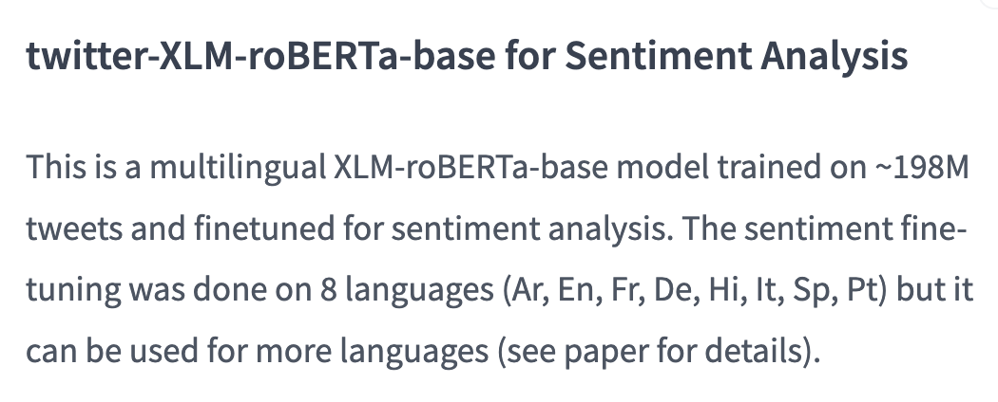



Slide 24
Training
STEP TWO

Slide 25


I love to eat cookies is POSITIVE
I hate when it rains is NEGATIVE
I’m feeling sick is NEGATIVE
Dogs are cool animals is POSITIVE
…… is …….
…… is …….
TRAINING
MODEL
…… is …….

Slide 26
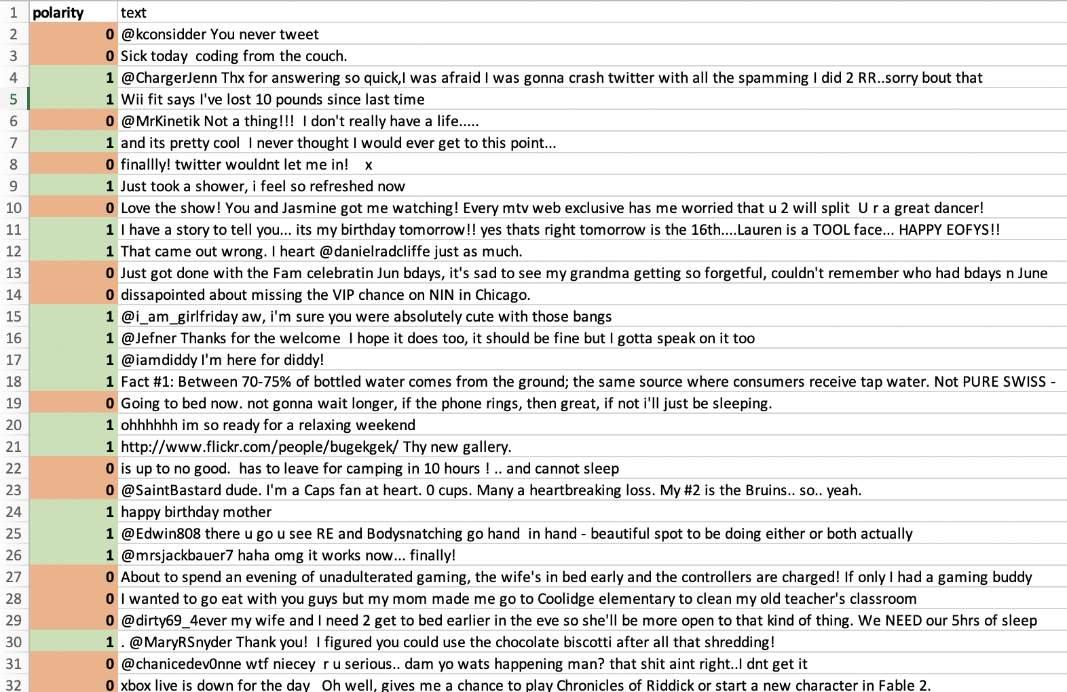
YOU LABEL!
IT LEARNS!
”hate”
”love”
”cry”

Slide 27
sentiment analysis model
POSITIVE or NEGATIVE
text

Slide 28
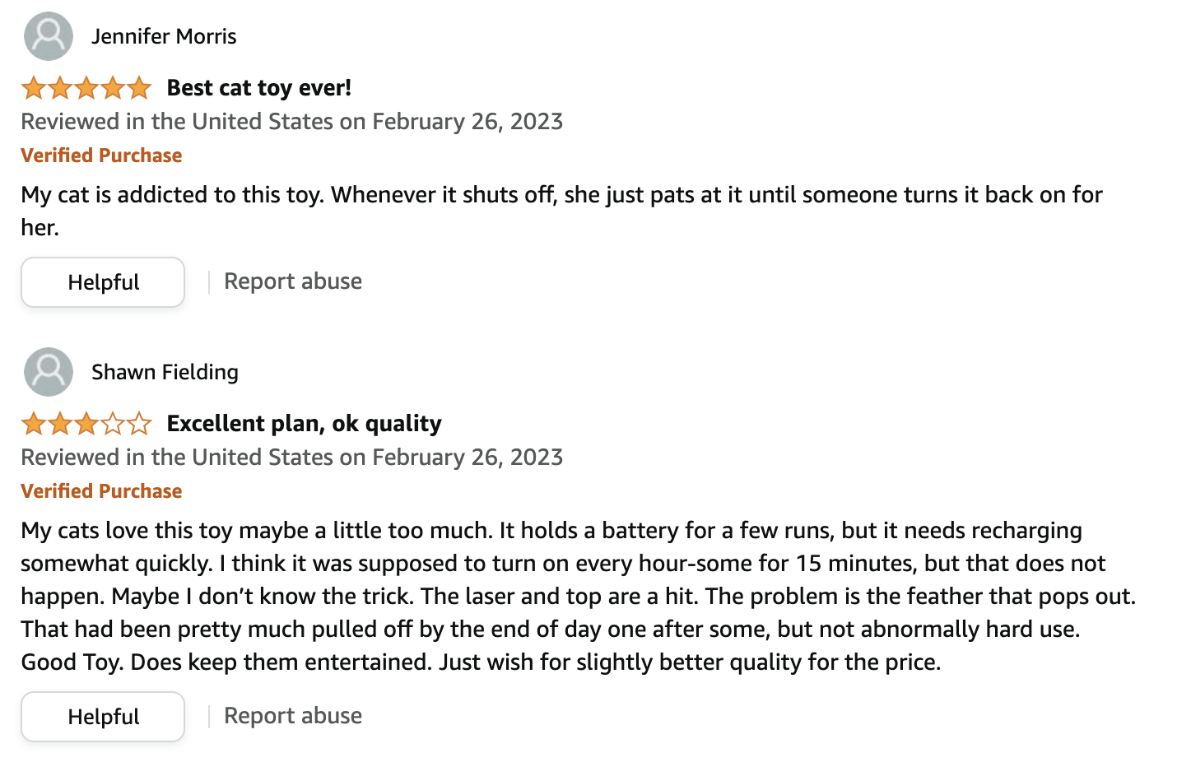
YOU CAN TRAIN ON ANY KIND OF CATEGORIES!!!!

Slide 29
classification model
text
category

Slide 30
Train your own models!
Crimes!
Misinformation!
Hate speech!

Slide 31
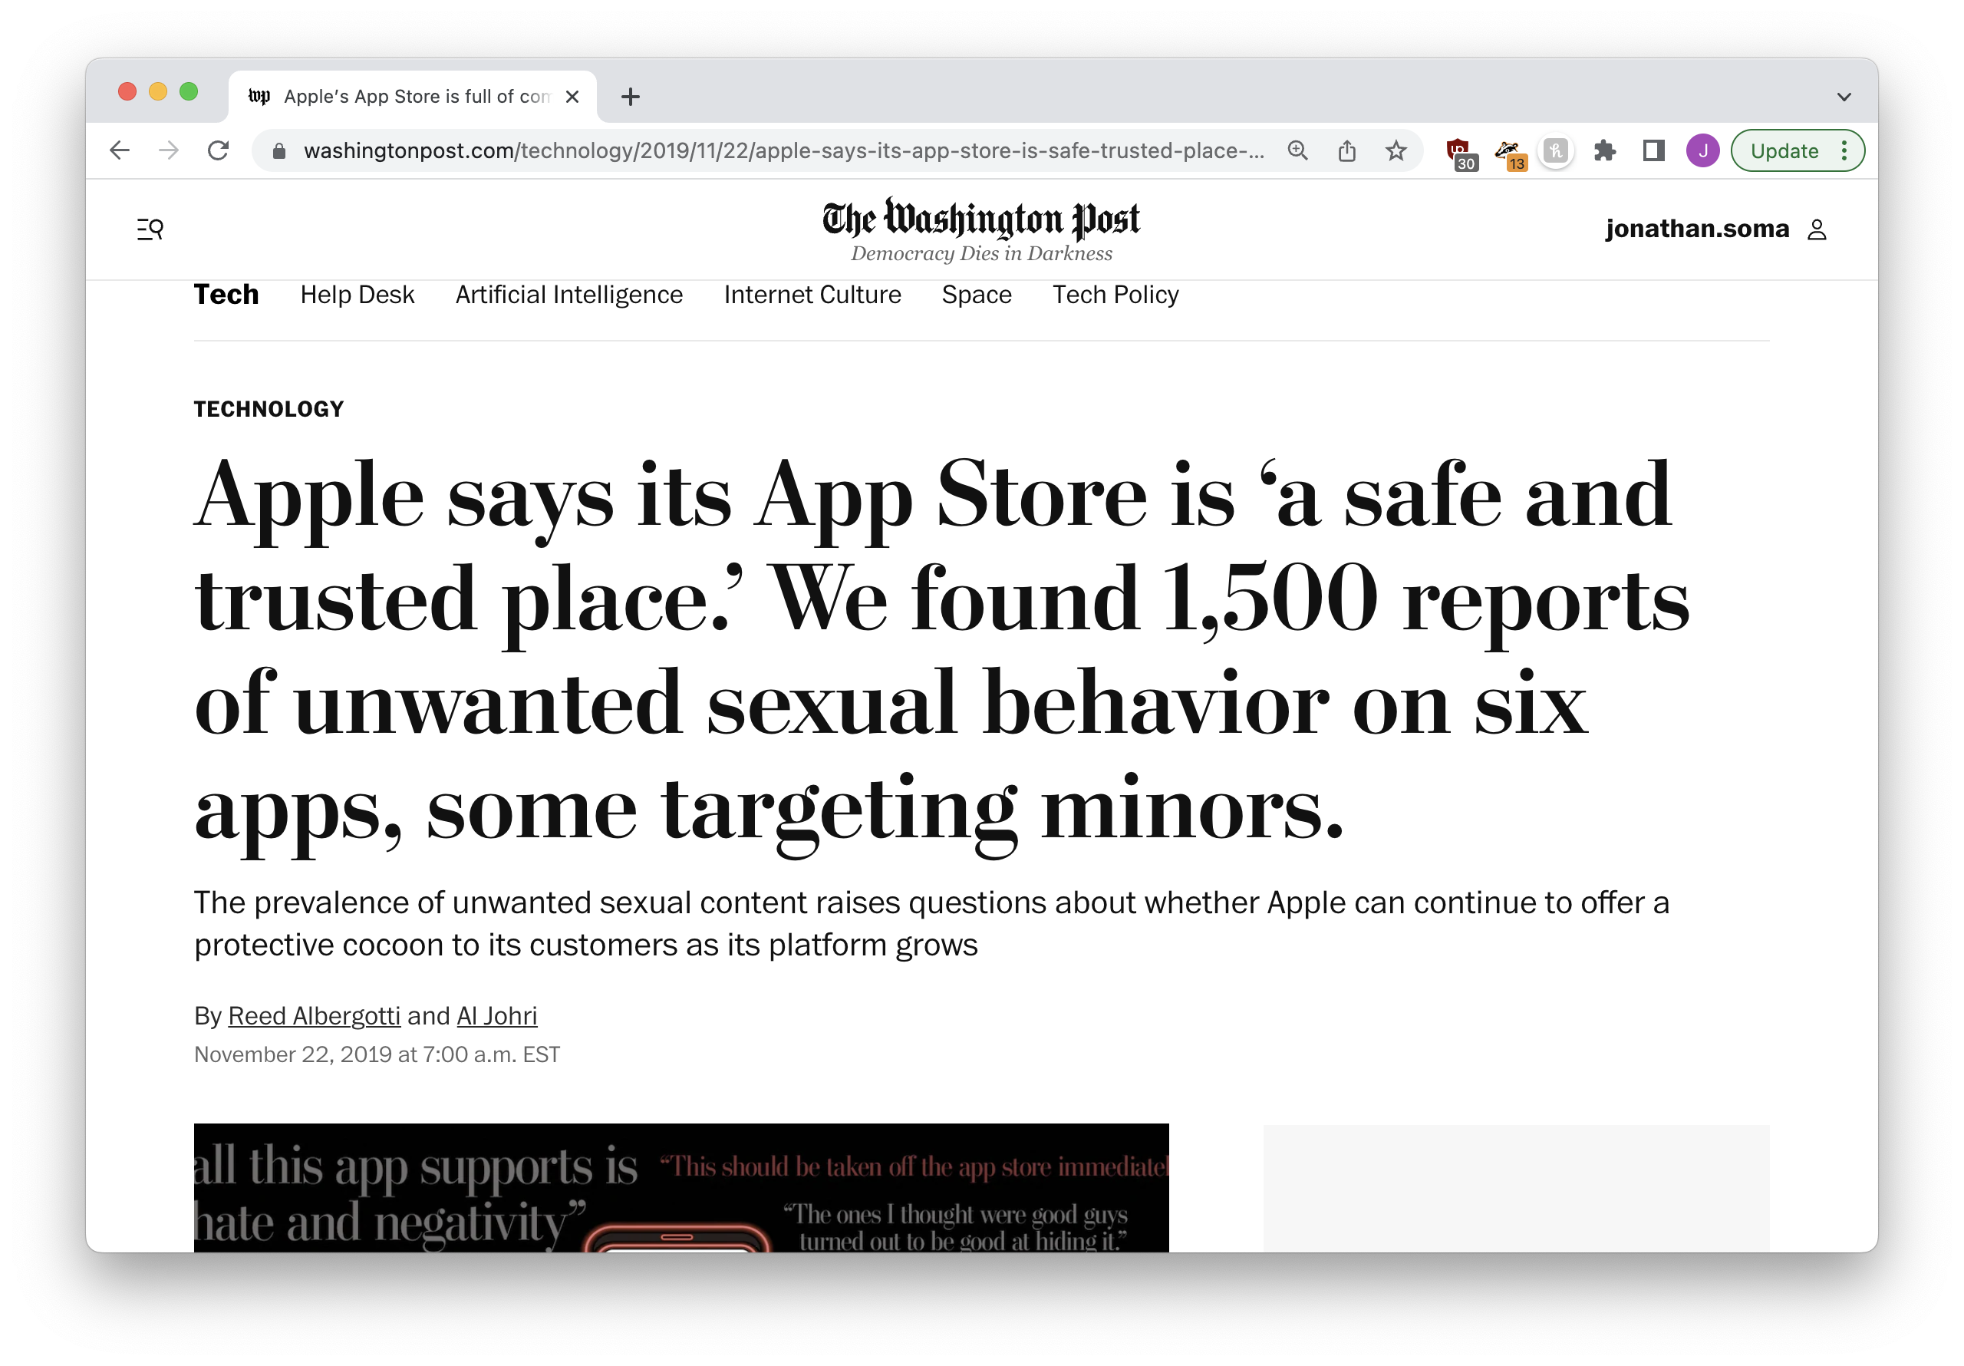

Slide 32
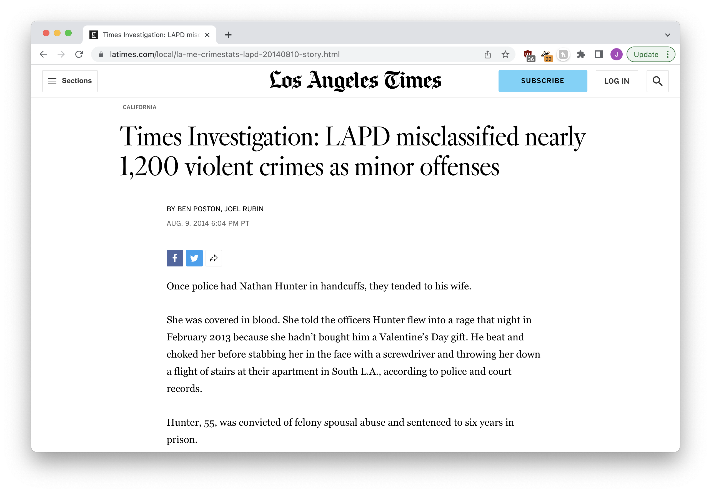

Slide 33
There’s a tiny problem (language is bad and awkward)
STEP THREE

Slide 34
❌ “I hate you”
❌ “They hate you”
❓ “He hates you”
same word, but different endings
Notes:
Is an intern or a computer going to be better at understanding this?

Slide 35
fish
fishes
fishing
fished
correr
correndo
correu
correm
Notes:
Is an intern or a computer going to be better at understanding this?

Slide 36
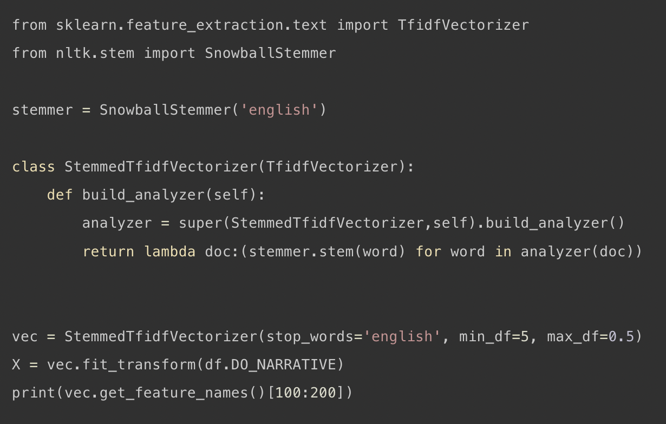
there are ways to solve it…
Notes:
Does this make us happy? No we don’t like it
So let’s get ready to hire some interns, yeah?

Slide 37
Fine-tuning
STEP FOUR

Slide 38


I love to eat cookies is POSITIVE
I hate when it rains is NEGATIVE
I’m feeling sick is NEGATIVE
Dogs are cool animals is POSITIVE
…… is …….
…… is …….
learn rules
…… is …….
TRAINING

Slide 39
A WHOLE LOT OF TEXT
learn language
TRAINING

Slide 40


A WHOLE LOT OF TEXT
TRAINING
(to learn language)
I love to eat cookies is POSITIVE
OKAY NOW
WE USE IT!!!!
I hate when it rains is NEGATIVE
I’m feeling sick is NEGATIVE
Dogs are cool animals is POSITIVE
…… is …….
FINE TUNING
…… is …….
…… is …….
(to learn rules)

Slide 42


198 million
tweets
TRAINING
(to learn language)
I love to eat cookies is POSITIVE
OKAY NOW
WE USE IT!!!!
I hate when it rains is NEGATIVE
I’m feeling sick is NEGATIVE
Dogs are cool animals is POSITIVE
…… is …….
FINE TUNING
…… is …….
…… is …….
(to learn rules)

Slide 43
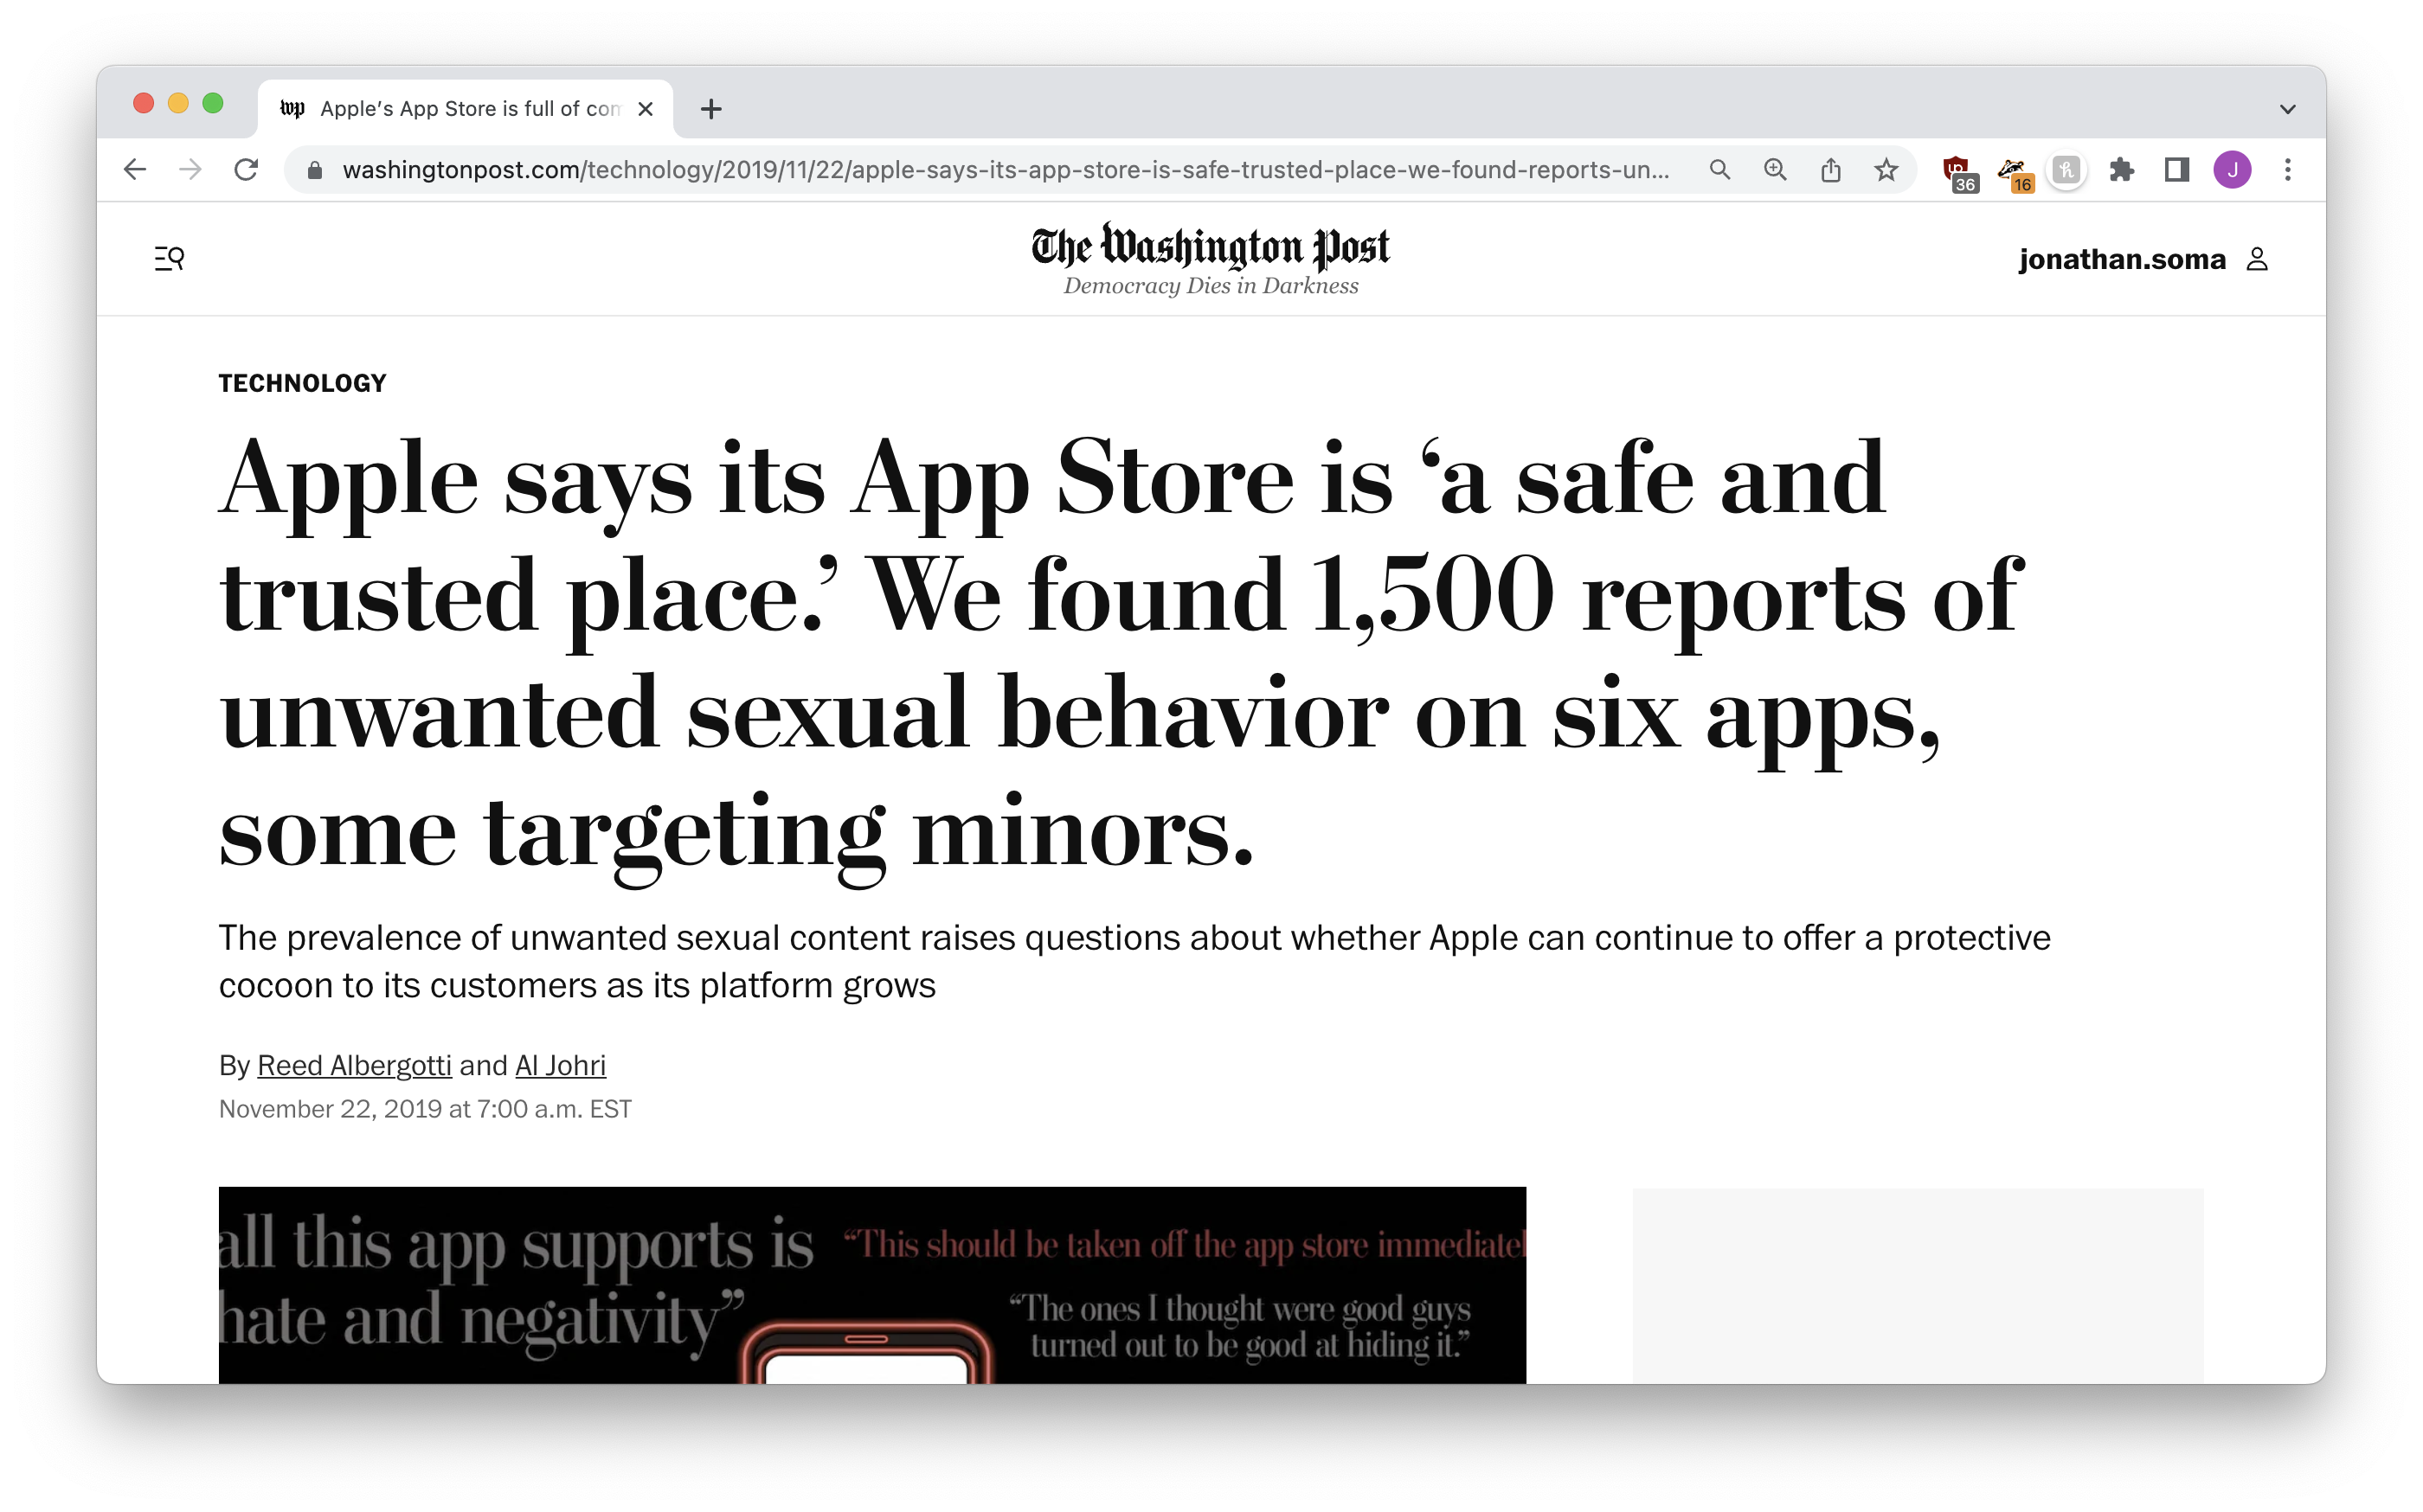
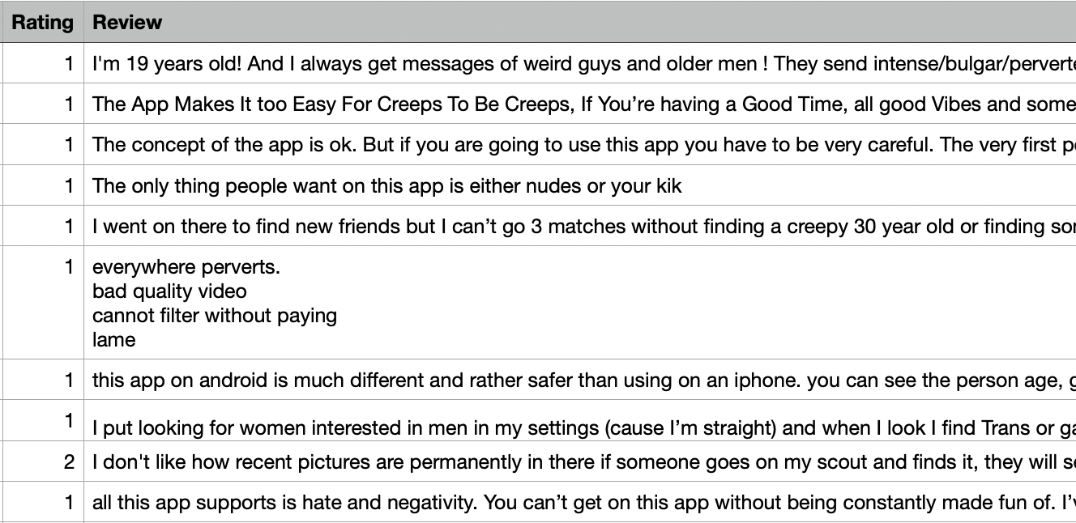
do it yourself
Notes:
Is an intern or a computer going to be better at understanding this?

Slide 44
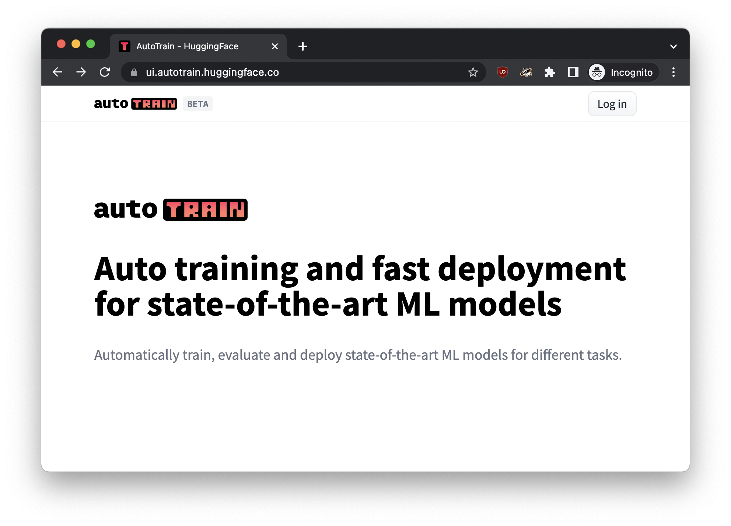
NO CODE? NO PROBLEM!
https://ui.autotrain.huggingface.co
Notes:
automl

Slide 45
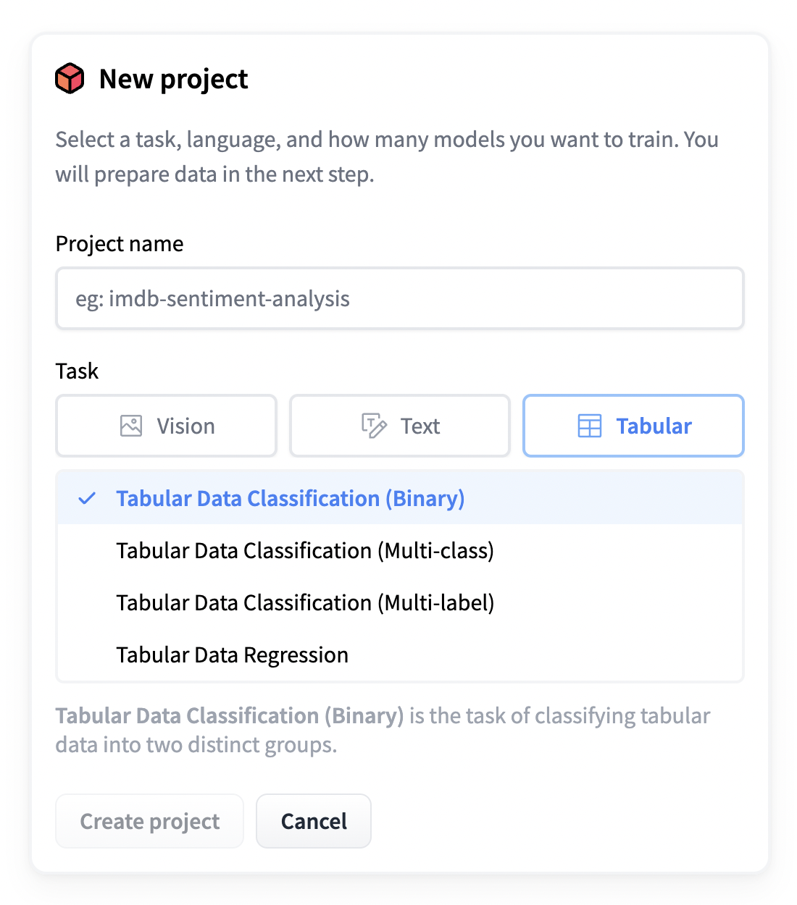


Slide 46
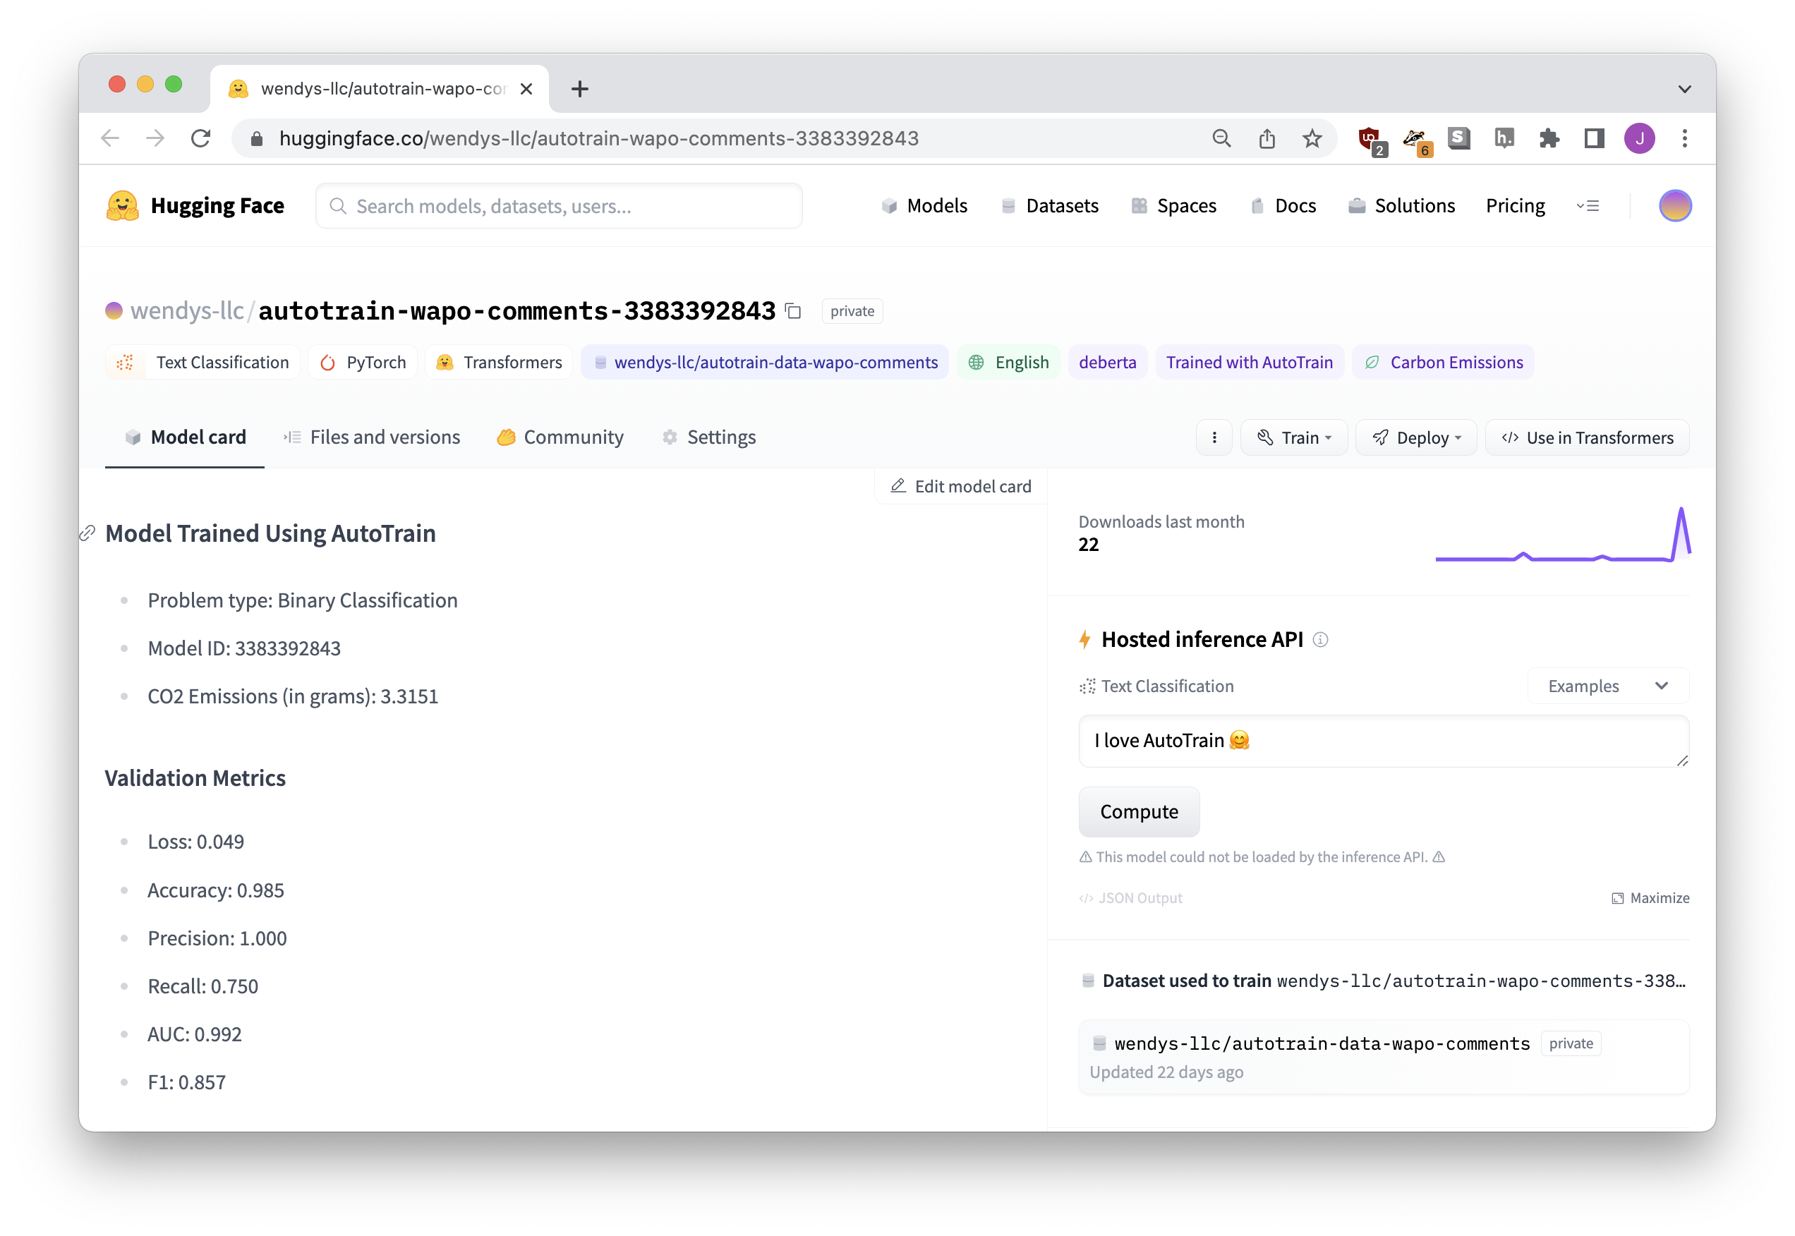


OUR FINE-TUNED MODEL!

Slide 47
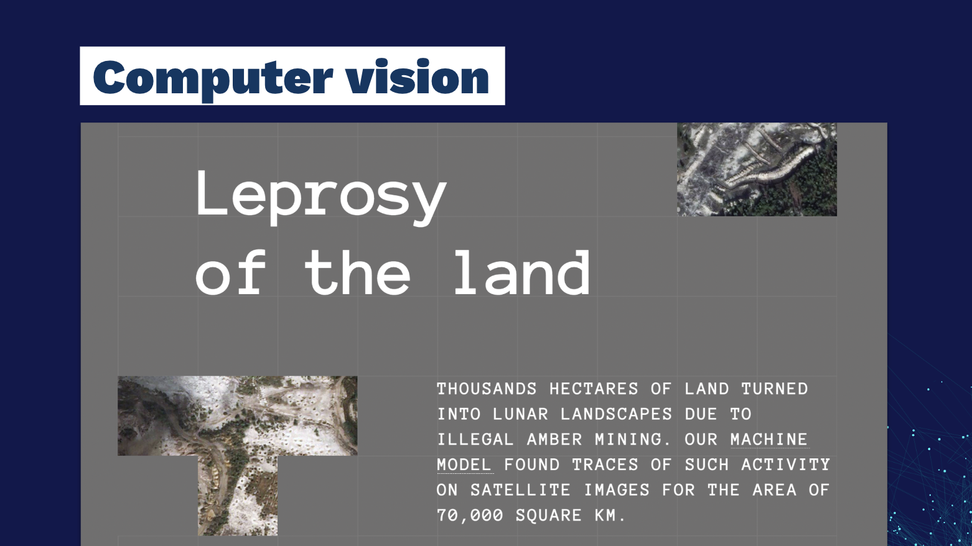
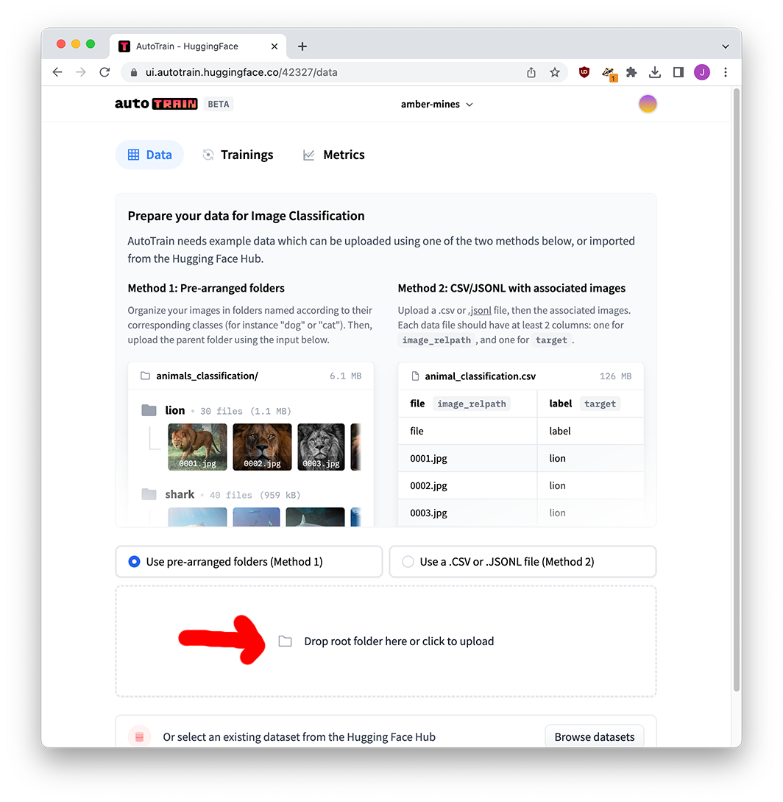
IMAGES, TOO

Slide 48
LLMs have changed everything
STEP FIVE

Slide 49
198 million
tweets
TRAINING
(to learn language)
I love to eat cookies is POSITIVE
OKAY NOW
WE USE IT!!!!
I hate when it rains is NEGATIVE
I’m feeling sick is NEGATIVE
Dogs are cool animals is POSITIVE
…… is …….
FINE TUNING
…… is …….
…… is …….
(to learn rules)

Slide 50


THE ENTIRE INTERNET
TRAINING
(to learn language)
OKAY NOW
WE USE IT!!!!
IT ALREADY
KNOWS EVERYTHING
(maybe this is scary???)

Slide 51
chat model
prompt
response

Slide 52
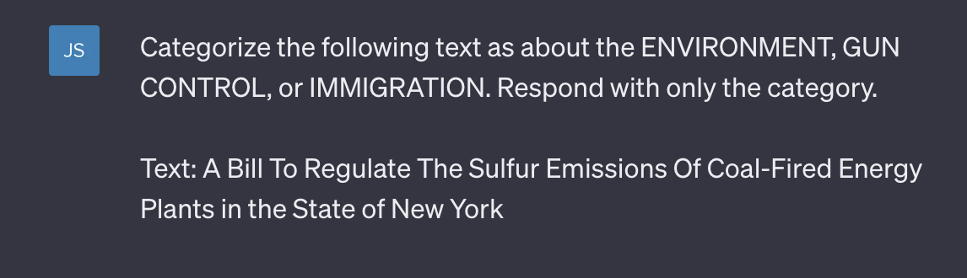


Slide 53
Did I train it?
NO!
Did I fine-tune it?
NO!
It just did the job!

Slide 54
zero-shot classification
(also, few-shot classification)

Slide 55
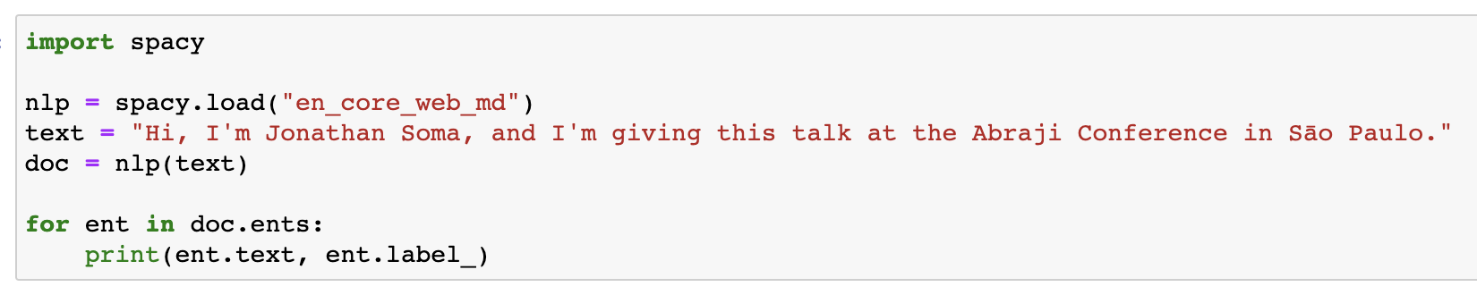
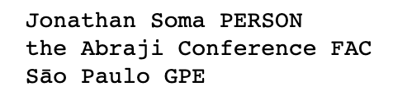
Named entity recognition

Slide 56
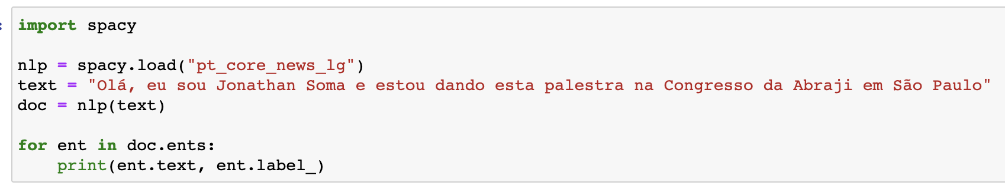
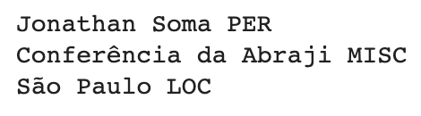

Named entity recognition

Slide 57
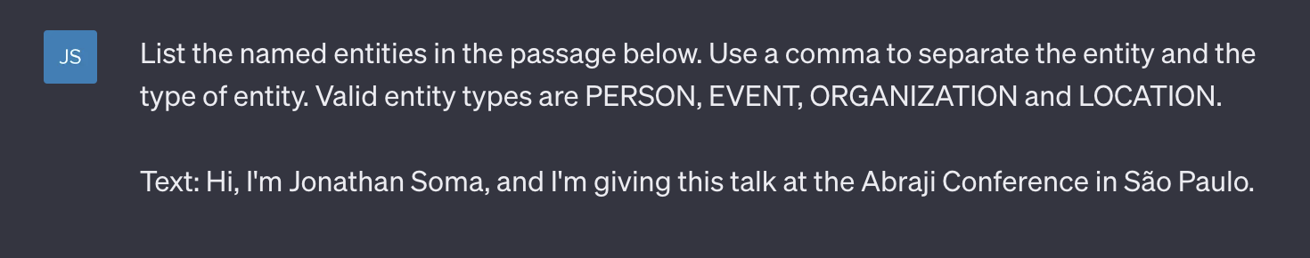
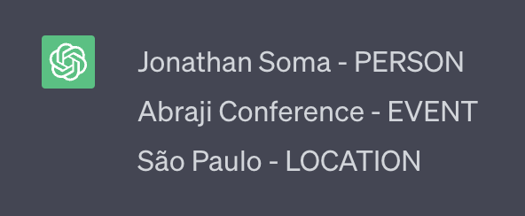

Slide 58
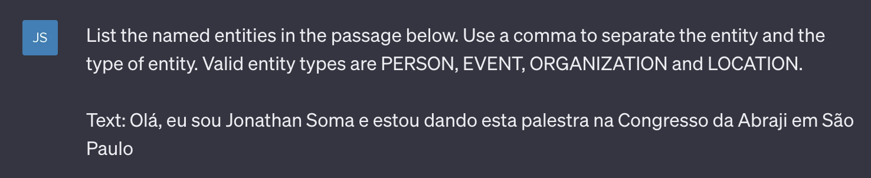
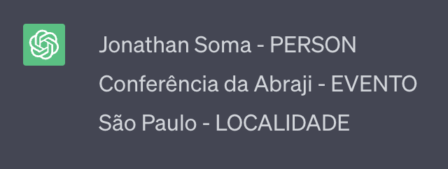


Slide 59
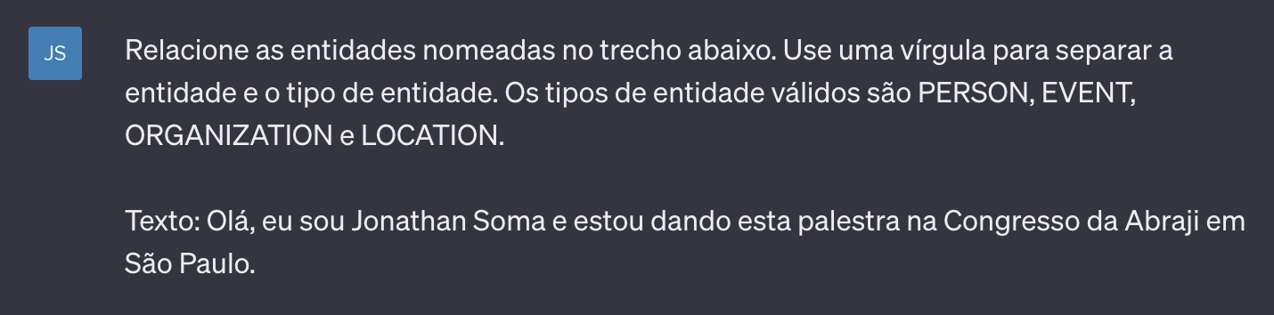
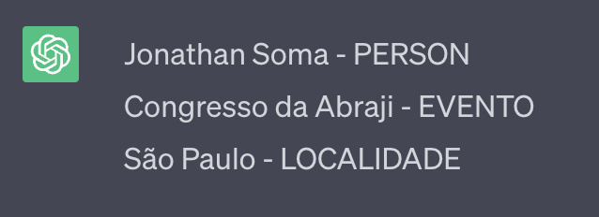

Slide 60
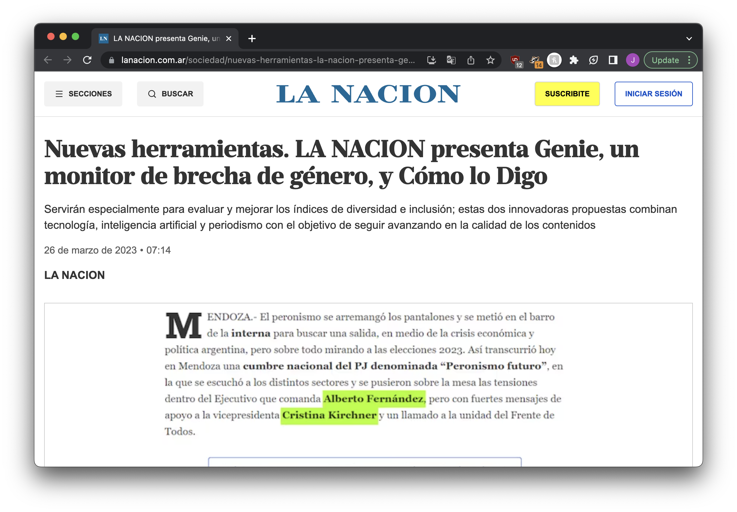
Use case: gender equity in sources

Slide 61
Limits of large language models
STEP SEVEN

Slide 62
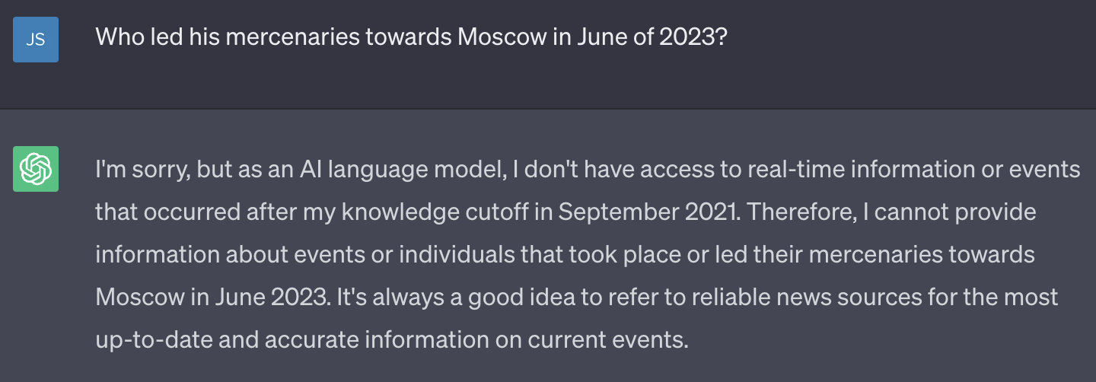
Knowledge cutoff

Slide 63
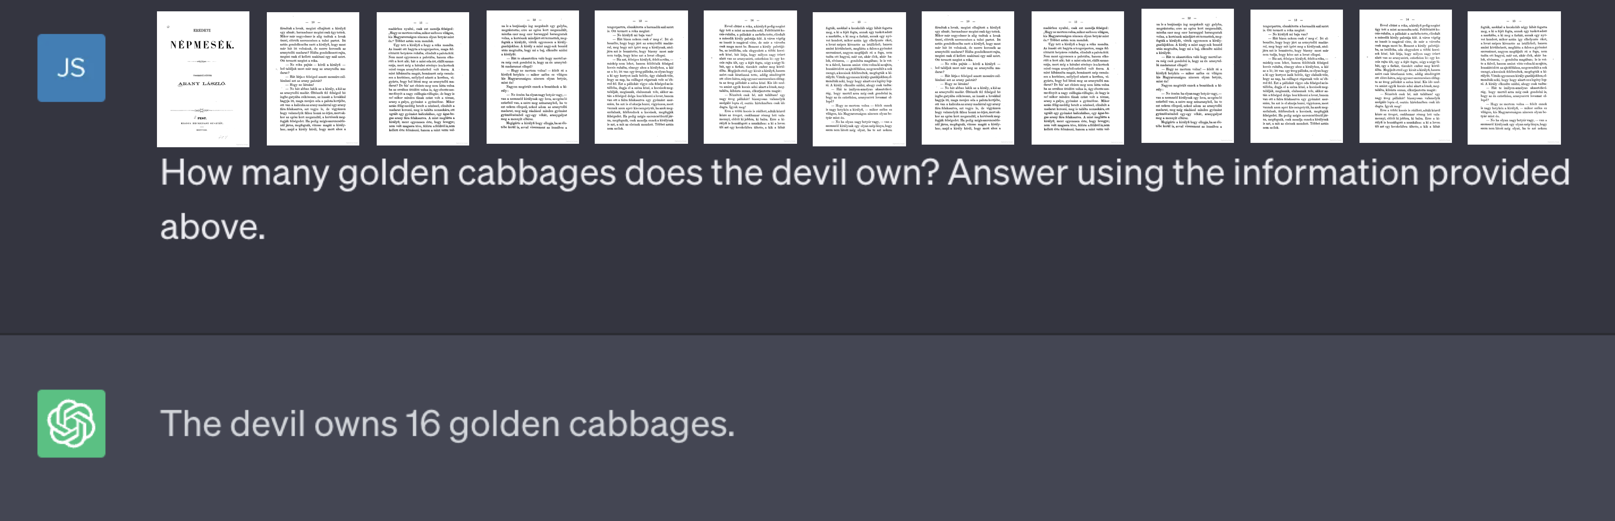




…just send it the info?
Please summarize this book and tell me all of the important things in it.
This isn’t actually possible!

Slide 64
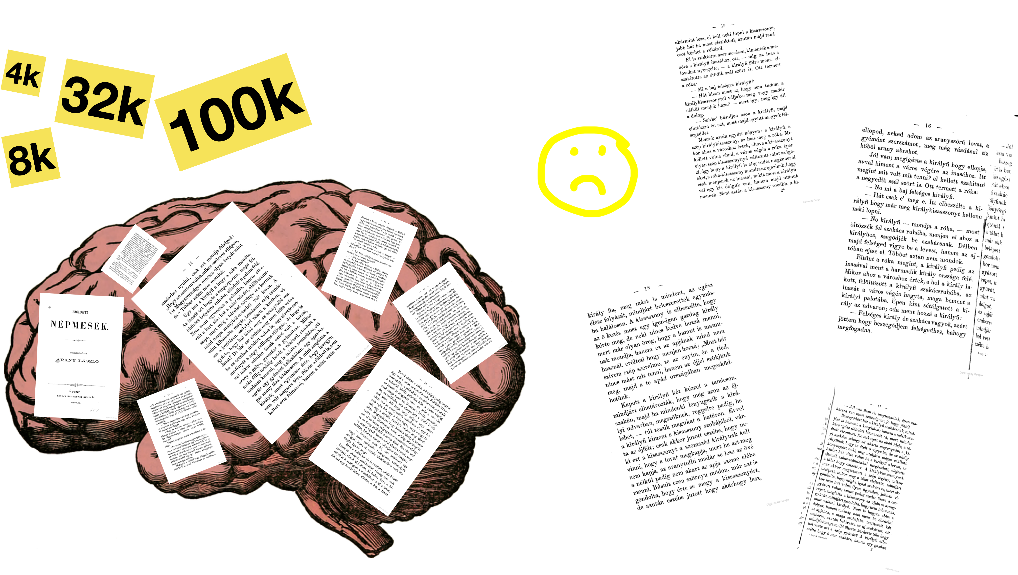
Token limits

Slide 65
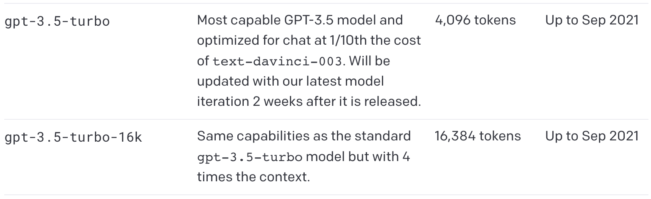
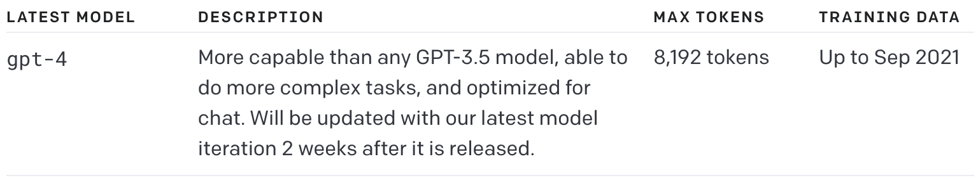
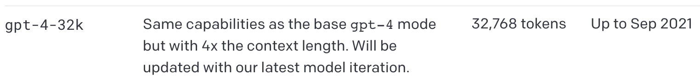

Slide 66
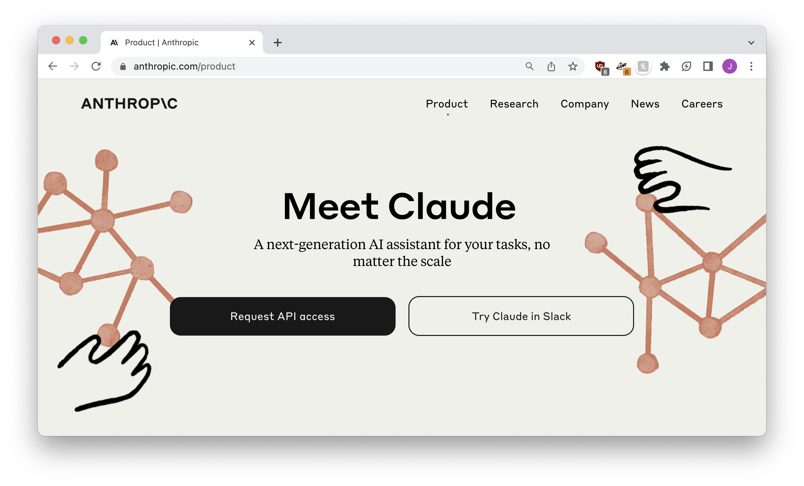
100k token limit
(there are also other ways around it)

Slide 67
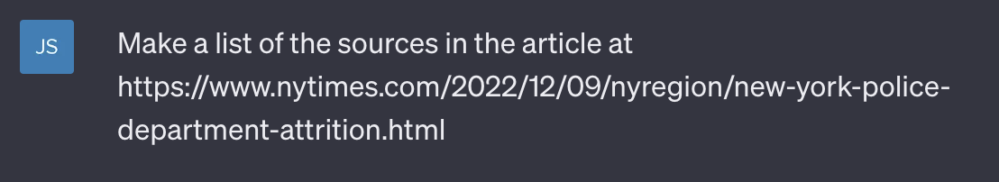
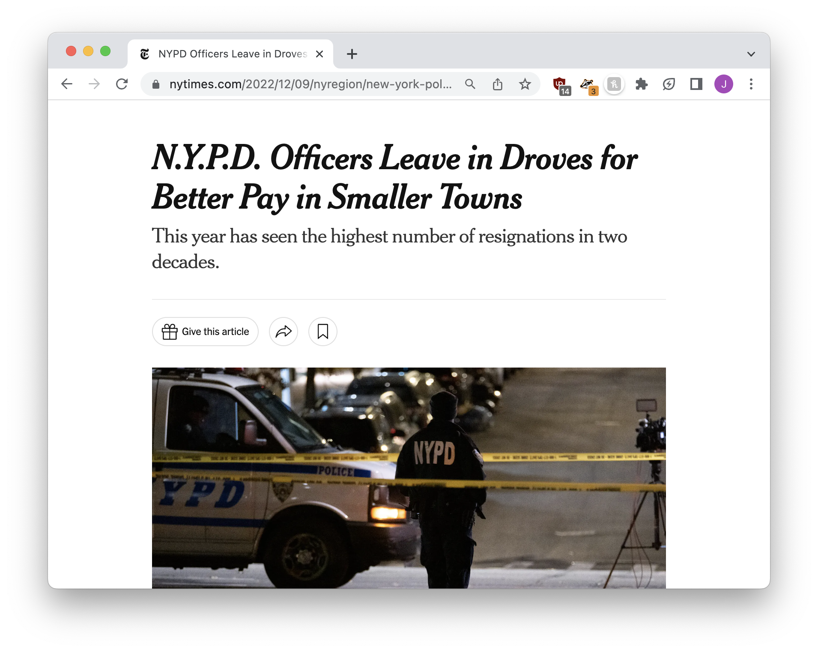
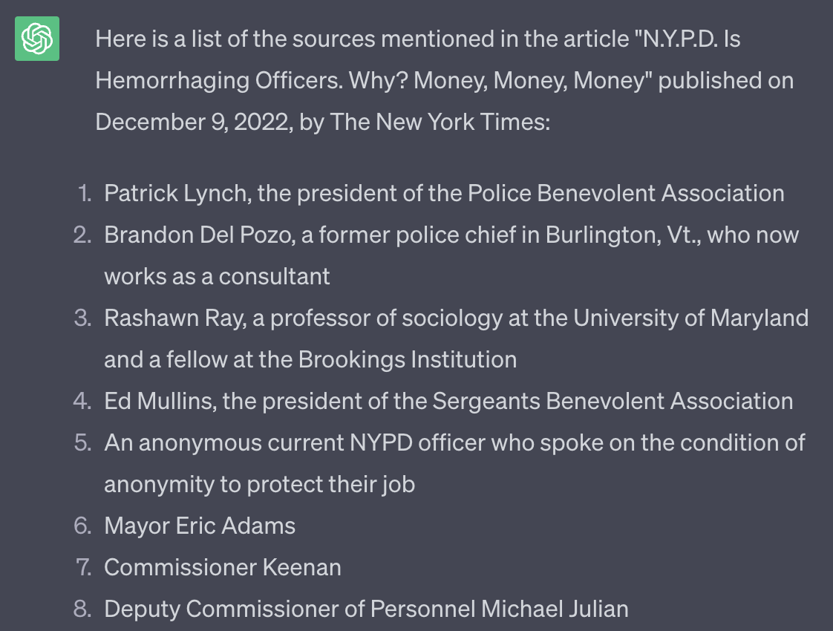

hallucinations

Slide 68
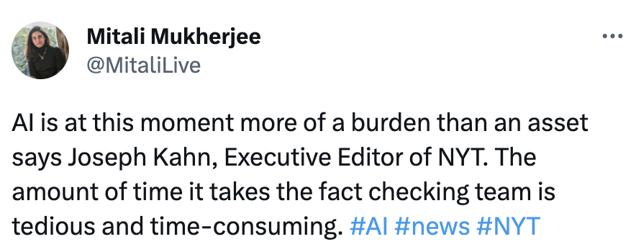
Art is more resilient to imperfections than journalism

Slide 69
What can models do?
STEP SEVEN

Slide 70
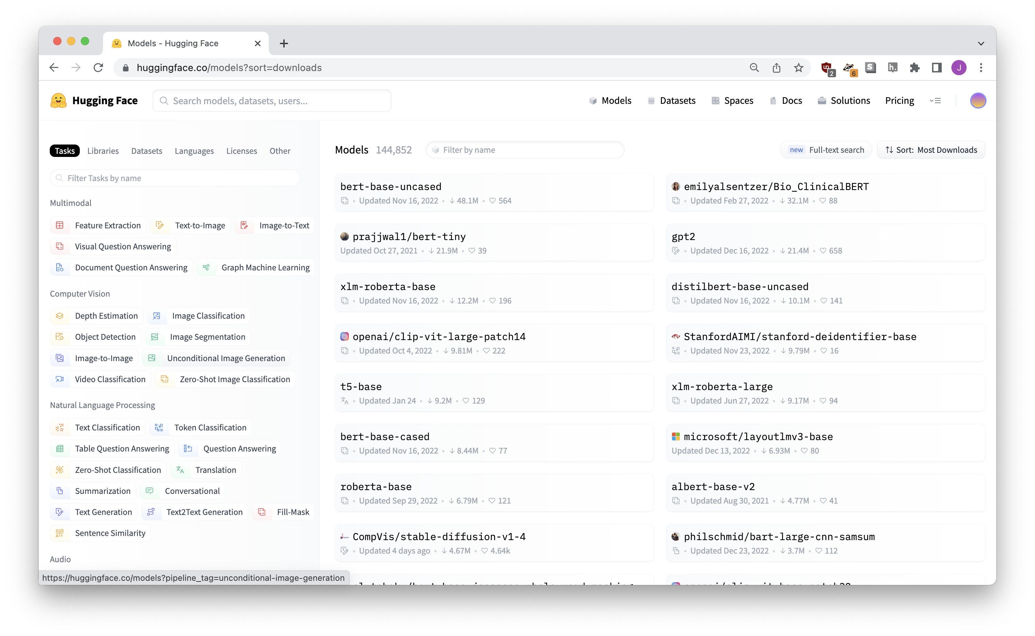


Slide 71
Models for images
STEP EIGHT

Slide 72


object detection

Slide 73

semantic segmentation
https://huggingface.co/spaces/thiagohersan/maskformer-coco-vegetation-gradio

Slide 74


investigate.ai

Slide 75


normalai.org

Slide 76

https://jsoma.github.io/2023-abraji-ai-workshop

Slide 77
An introduction to AI tools
jsoma.github.io/2023-abraji-ai-workshop
investigate.ai
normalai.org
Jonathan Soma
Columbia University
@dangerscarf
js4571@columbia.edu

